Slide 1
Chapter Building Workshop

Slide 2


Thank You!
Bless You!
You Rock!

Slide 3


Washington State
and Oregon HLAA Chapters

Slide 4
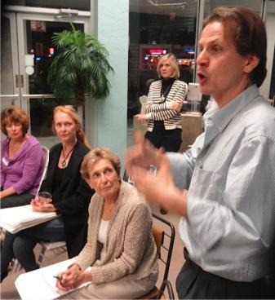
Agenda

Slide 5

Introductions
Top Goal/Program

Slide 6

Top Questions for the Day
What does HLAA do?
How does HLAA contribute to local chapters?
How do we attract more members?
  More active members?
  More contributing members?
  How do we keep active/contributing members?
How can we nurture volunteers?
How to attract younger members?
Long term planning?

Slide 7

Top Questions for Today – How Do We
Get people more involved/get more volunteers
Get more dynamic leaders
Attract more members/grow a chapter
Attract more younger people
Fundraise
Reach out to community

Slide 8
Other Questions – How Do We
• Get members to advocate for themselves
• Find great speakers
• Support Veterans
• Get media coverage for meetings
• Convince venues to add a loop system
• Restore/Strengthen State Organizations
• Connect with other chapters

Slide 9
What’s Our Chapter’s 5 Year Forecast ?
Chapter Closes Unless More Resources
Decline in Membership
Remain Stable
10% Annual Growth in Membership
20% Annual Growth
Over 20% Annual Growth YES!!!!!!!

Slide 10

There Is A
Market Opportunity
for Each Chapter

Slide 11

The Opportunity
Huge hearing loss population
• 20% of population
• 1 out of every 5 people
HLAA Delivers their Major Needs
• Information
• Support
• Education
• Meet people like you and me
What if you attract 2% of them?
HLAA changes lives

Slide 12

The Washington State Opportunity
Chapter | 2010 Census population | People w Hearing loss (20%)
East Jefferson County WA | 21,720 | 4,344
Renton WA | 90,927 | 18,185
Spokane WA | 666,247 | 133, 249
Tacoma-Seattle Area | 3,439,809 | 687,962
Total | 4,218,703 people | 843,740 people

Slide 13
The Oregon Opportunity
Chapter | 2010 Census population | People w Hearing loss (20%)
Douglas County OR | 107,667 | 21,533
Lane County OR | 351,715 | 70,343
Linn & Benton OR | 202,248 | 40,450
Portland OR | 2,226,009 | 445,202
Salem OR | 390,738 | 78,148
Whatcom OR | ?? | ??
Total | 3, 278, 377 people | 655,676 people

Slide 14

The Washington 2% Opportunity
Chapter | People with Hearing Loss | Suppose 2% Join Your Chapter
East Jefferson County WA | 4,344 | 87 Members
Renton WA | 18,185 | 364 Members
Spokane WA | 133, 249 | 2665 Members
Tacoma-Seattle Area | 687,962 | 13,739 Members
Washington State Opportunity | 843,740 people | 16,875 Members

Slide 15
The Oregon 2% Opportunity
Chapter | People with Hearing Loss | Suppose 2% Join Your Chapter
Douglas County OR | 21,533 | 431 Members
Lane County OR | 70,343 | 1,407 Members
Linn & Benton OR | 40,450 | 809 Members
Portland OR | 445,202 | 8,904 Members
Salem OR | 78,148 | 1,563 Members
Whatcom OR | ?? | Members
Oregon State Opportunity | 655,676 people | 13,113 Members

Slide 16
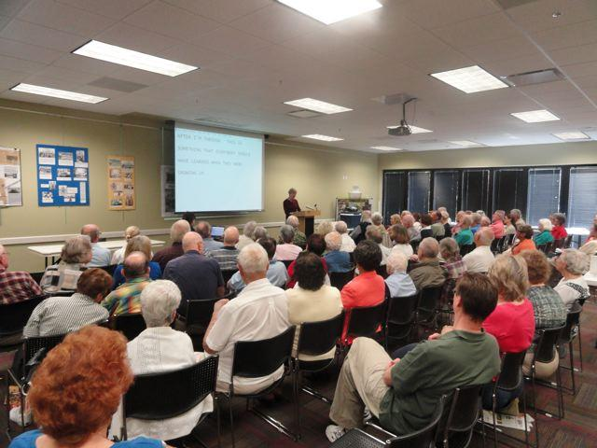
How do we create and attract……
More Involved Members?

Slide 17

Overall Strategy/Plan

Slide 18

Successful chapters answer two basic questions:
Who are we trying to attract?
What of value do we offer & why should they come?

Slide 19
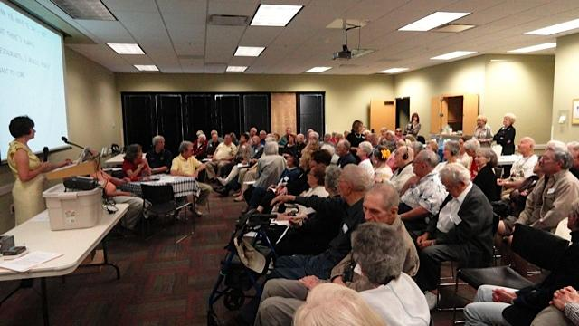
Who are you trying to attract?

Slide 20

Why should they come?
What specifically does your chapter offer?
What is the value of coming to meetings?
What needs are addressed?

Slide 21
EVERYONE DOES NOT NECESSARILY
WANT THE SAME THING
WHO are you trying to attract? | WHY would they want to come?
First-time visitors | Information
 | Support

Slide 22
EVERYONE DOES NOT NECESSARILY
WANT THE SAME THING
WHO are you trying to attract? | WHY would they want to come?
First-time visitors | Information
 | Support
Returning visitor | Education
Member < 2 years | Education

Slide 23
EVERYONE DOES NOT NECESSARILY
WANT THE SAME THING
WHO are you trying to attract? | WHY would they want to come?
First-time visitors | Information
 | Support
Returning visitor | Education
Member < 2 years | Education
Member > 2 years | Social & Friendship

Slide 24
EVERYONE DOES NOT NECESSARILY
WANT THE SAME THING
WHO are you trying to attract? | WHY would they want to come?
First-time visitors | Information
 | Support
Returning visitor | Education
Member < 2 years | Education
Member > 2 years | Social & Friendship
Spouses/Partners | Support & Education

Slide 25
EVERYONE DOES NOT NECESSARILY
WANT THE SAME THING
WHO are you trying to attract? | WHY would they want to come?
First-time visitors | Information
 | Support
Returning visitor | Education
Member < 2 years | Education
Member > 2 years | Social & Friendship
Spouses/Partners | Support & Education
Community-at-large | Advocate on Behalf of Chapter Members

Slide 26
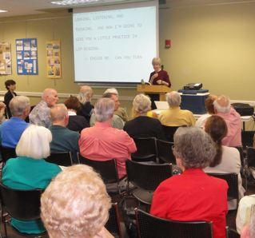
Attendance + Membership Equals Delivery of Mission

Slide 27

Mission
To open the world of communication to people with hearing loss through:
• information
• education
• support • advocacy

Slide 28
Mission
To open the world of communication to the 149,400 local people with hearing loss through:
• information
• education
• support
• advocacy

Slide 29

Why # of local people with hearing loss?
Shows those with hearing loss they are not alone
Demonstrates opportunity to meet people like yourself
Proves the need for advocacy (1 in every 5 people)
Communicates the media’s opportunity for supporting you
  Highlights number of potential readers or viewers
States the business opportunity for equal access
  Highlights the number of potential “customers”
Indicates number of potential voters to politicians

Slide 30
Attendance & Membership Drivers
• information
• education
• support
• advocacy

Slide 31

Information/Support Plan

Slide 32

An Information / Support Plan is Critical
Address 1st Time Visitor’s Biggest need
  One issue or concern is often their roadblock
  We need to answer more than 41% of Q.s satisfactorily
Address Partner’s Biggest Need
  Biggest sources of new members and added attendance

Slide 33

Keys to Chapter Growth
Convincing majority of visitors to return by “delivering mission”

Slide 34

Chapter Health Monitor
Health Factor | Measures
Number of first time visitors per meeting | Programs’ Appeal Promotion Effectiveness
% who return to chapter meetings | Overall Program Delivery
% who become paying, active members | Value, Message Effectiveness
% who become volunteers | Leadership Effectiveness
% who become leaders | Leadership Effectiveness

Slide 35

Welcome Strategy

Slide 36
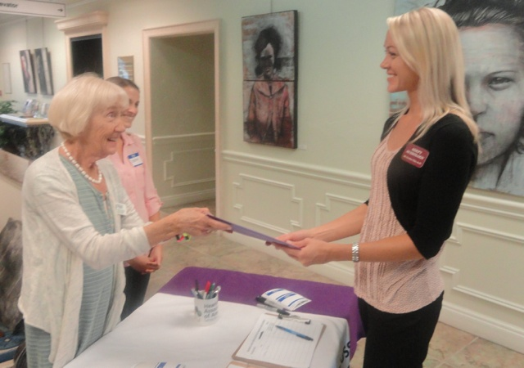
1st Visit / Impressions
What works? What doesn’t?

Slide 37



First Time Visitor’s State of Mind
Very Anxious
  Cannot hear well at home/ meetings
  Peer pressure to get resolution
  What kind of “support meeting” to expect?
Has a need
  Needs to improve hearing
  Not happy with hearing aid/treatment
  Confused about options/best choice
Hung up about:
  Stigma
  Cost $$$
  Which hearing aid?
  Who to see?

Slide 38

Greeting Strategy
Warm Greeter
Information Table
Sign-in Sheet
Welcome “Kit”
Coded Name Tag
Leader Greeting
Ready for Common Questions

Slide 39

Information Table
Branded as an HLAA Chapter #
Welcome Flyer
  Mission
  When Meets
  Where Meets
  Support & Information Contacts
Next Meeting Flyer
Access in the community flyer
Hearing Loss Magazine # w/chapter label on front
Other HLAA flyers #
# denotes available from HLAA Online Store

Slide 40
Welcome
Flyer
Template

Slide 41
Leaders’ Role to welcome
Welcome newcomers
Set visitor’s expectations for the session
Address their question/needs
Mention any upcoming meetings of interest
Introduce them to members/mentors/leaders
Invite them to connect after meeting
Send welcome e-letter after meeting

Slide 42

Leaders’ Role to Welcome
Welcome newcomers
Set visitor’s expectations for the session
Address questions/needs
Mention any upcoming meetings of interest
Introduce them to members/mentors/leaders
Invite them to connect after meeting
Send welcome e-letter after meeting

Slide 43

Most Common Questions?

Slide 44

The #1 Question:
How to get cost of hearing aids down?

Slide 45
Cost of Hearing Aids
$1500 - $10,000 Each
Testing
Device Selection
Fitting & Adjusting
Programming
Reprogramming
Re-testing
Maintenance & Repair

Slide 46
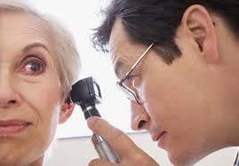
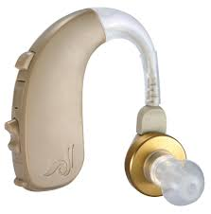
Explain the “Bundle”
+
Not just buying a hearing aid,
But a bundle of services as well

Slide 47

Bundle = Cost of Device Includes…
Evaluation
Hearing test
Device selection
Fitting
Mapping
Programming
In-office repairs
Cleanings
Counseling
Co-pay / re-stocking fee
Warranty

Slide 48
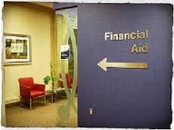
Sources of Information about Financial Support
Sertoma
Vocational Rehabilitation
Veterans Admin
HLAA website (Support – Financial Aid) HLAA’s #1 Cause is Access to Affordable Hearing Healthcare
Local Groups

Slide 49

#2 Question
“What is the best hearing aid?

Slide 50
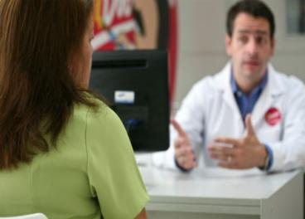
Best Hearing Aid determined by:
1. Needs identified in Hearing Test
2. Your Lifestyle Hearing Needs
3. Best technology to address 1 and 2

Slide 51

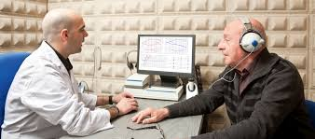
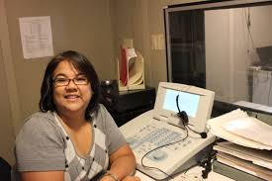
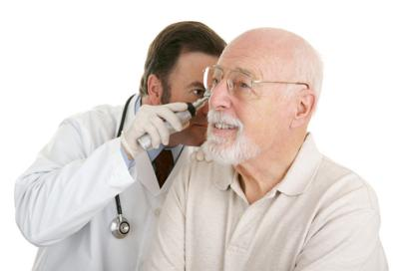
“Can you recommend an audiologist?”
#3 Question

Slide 52
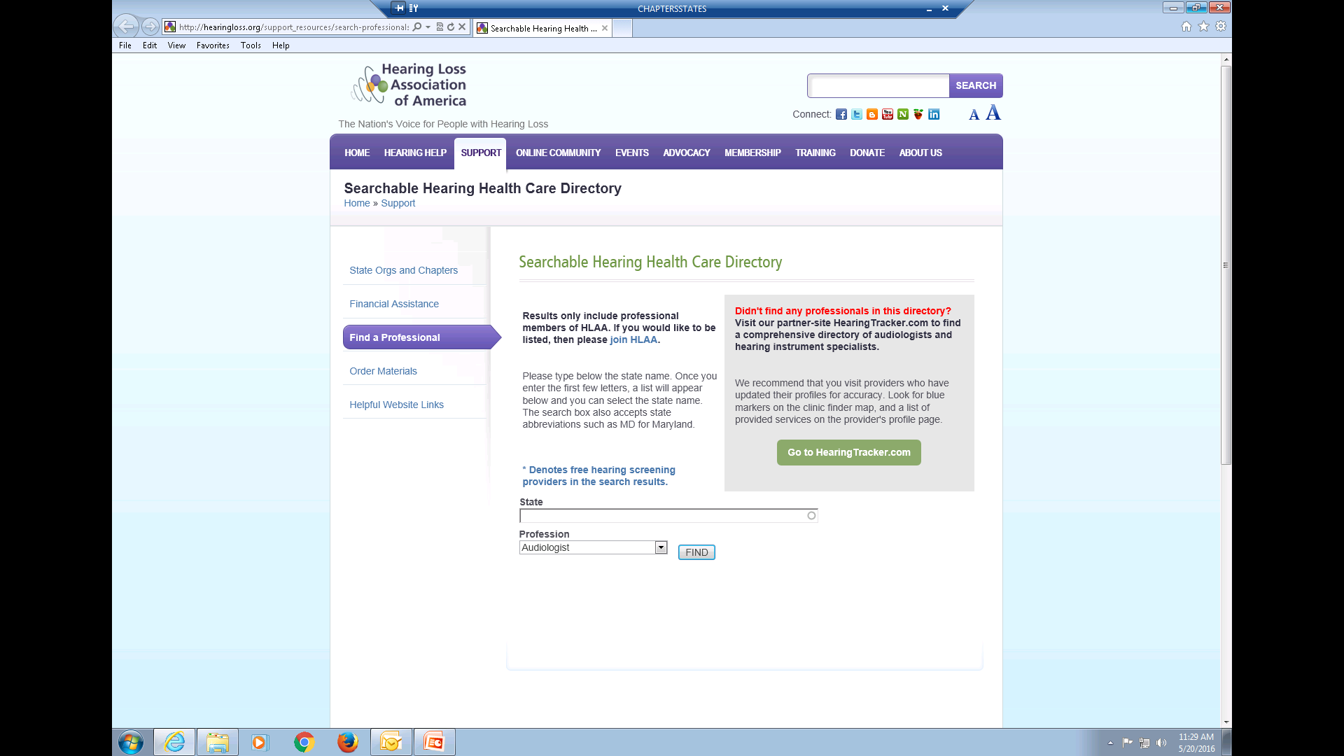
http://hearingloss.org/support_resources/search-professionals

Slide 53

#3 Question
Can you recommend an “audiologist” ?
Offers multiple brands of hearing aids: Oticon, Phonak, Resound, Siemens, Starkey, Widex to name but a few
Offers multiple styles of hearing aids, including BTE Behind the Ear, CIC Completely in Canal, and everything in between!
Answers all your questions completely and patiently
Asks about your lifestyle and activities to completely understand your needs
CHEMISTRY! Listens to you, reacts to what you tell them about your needs and lifestyle.

Slide 54
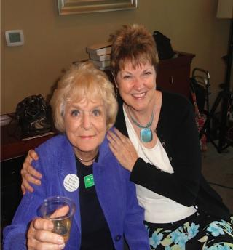
Support Plan

Slide 55
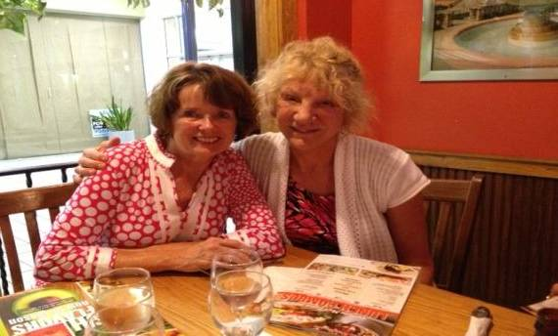
Mentors are the foundation
• Introduce newcomers to mentors
• Feature mentors at all meetings
• Feature mentors in chapter “welcome kit”

Slide 56
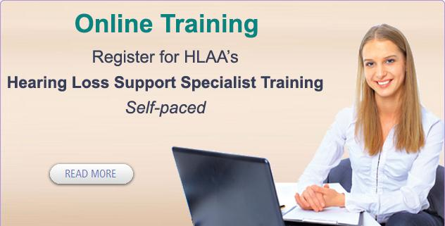
Develop Mentors – Option 1

Slide 57

Develop Mentors – Option 2
On-site Peer
Mentoring Program

Slide 58
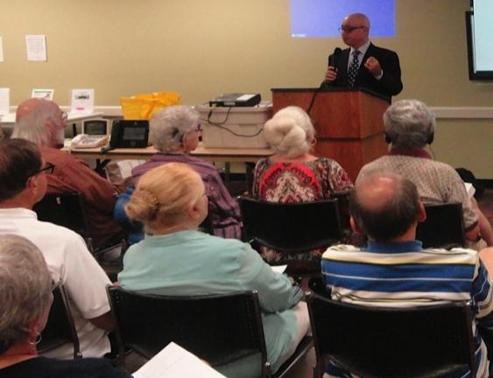
Education

Slide 59

Education Basics - All Meetings
Introduce CART
Introduce Loop / T-coil
Introduce Mentors
Introduce Other Leaders
Community access opportunities
• Captioned Movies • Looped Venues
Information Table
Introduce an ALD (optional)
Meet a Member (optional)

Slide 60

Communication Access is essential

Slide 61

Education Plan

Slide 62
Education Plan
Promote HLAA Mission in all communications
Focus on topics before speakers
Create a written topics “Wish List” for 12-18 months
  Member, spouse, guest input
Network the list to get speaker recommendations

Slide 63
Education Plan
Topics should be benefit oriented
Improve one’s hearing, listening or communication skills
“How to improve communications when one of you is hard of hearing”
versus
“Coping with Hearing Loss”

Slide 64
Education Plan
At Least 3 Learning Objectives
As a result of attending this session you will learn how to:
• Avoid the roadblocks to successful communication
• Self-advocate for your listening needs
• Support a loved one with hearing loss in conversations

Slide 65

Annual Education Goal
Thinking about what you have learned from the chapter’s meetings in the past year, what effect would you estimate has it had on improving your listening and communication skills?

Slide 66
Meeting Flyer Template

Slide 67
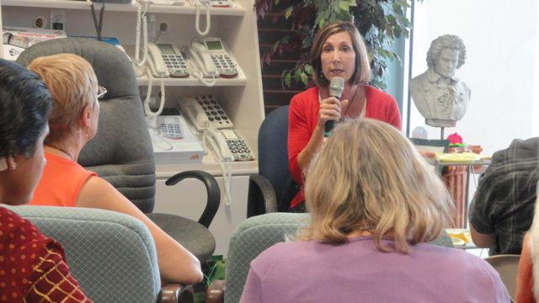
Presentations
What topics are the best?

Slide 68

Best Presentations
Best at Opening World of Communication
• Communication Strategies
• Assistive Listening Devices
• Demystifying Hearing Aid Purchase
Best at Spiking Attendance
  • Communication Strategies for Couples
  • Latest ALD Technologies
  • Latest Hearing Aid or CI Technologies
Best at Improving Listening & Communication Skills
  • Auditory Training- LACE, Read My Quips, Brain HQ
  • Communication Strategies for Noisy Situations

Slide 69
Create A State-wide Speaker’s Bureau
• Chapters’ Most Popular Topics/Speakers
• Audiology Professors
• Videos

Slide 70
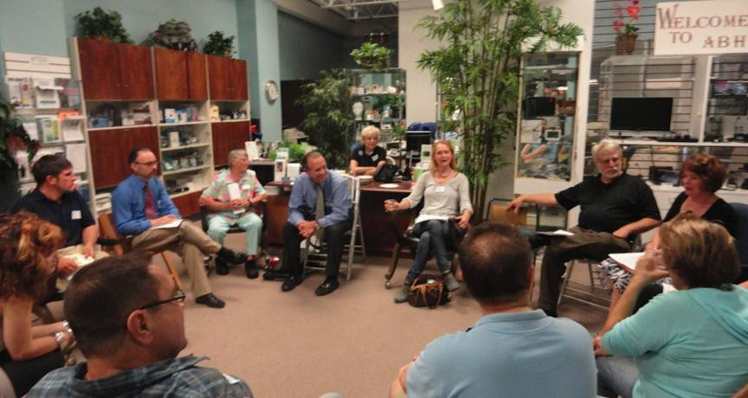
Rap Sessions

Slide 71
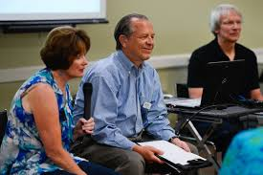
Rap Session Checklist
Need a Moderator & Mentor
Promote reasons to attend
Purpose of a rap session
  Raise your questions and concerns
  Learn how to manage your issues
  Learn how to support others
  Learn about the latest access
Plan icebreaker question(s)
Probe issues behind questions
Who else has experienced this?
What other ways have you addressed this?
Have planted questions ready

Slide 72
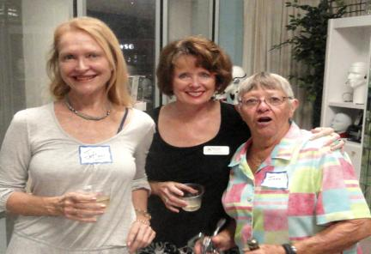
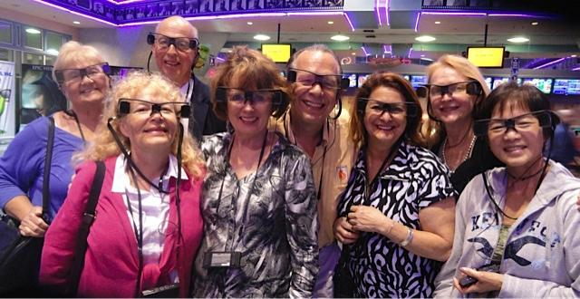
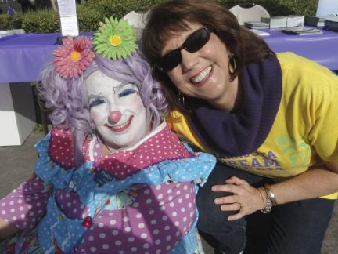
Social Plan

Slide 73

Why social is so important
Many miss social interaction in their lifestyle
“Meeting people like me” is a top reason for joining HLAA
After 2 years, social is the key reason many members stay
Social facilitates the interest to volunteer

Slide 74

Social Time @ Meetings
Meet & Greet
Involve the Leaders
Mini Rap Session
“Meet a Member”
Post-Speaker Social Time

Slide 75
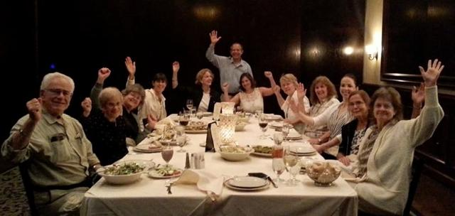
Social time outside the meetings
Holiday Parties
Picnics
Dinners
Community Receptions
Volunteer Receptions
Community Outings to
movies, theatres, museums, sporting events

Slide 76
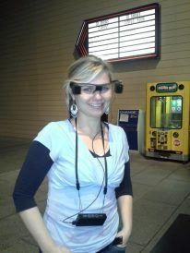

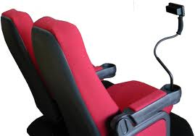

Captioned Movie Night
Captiview Sony Caption Glasses

Slide 77
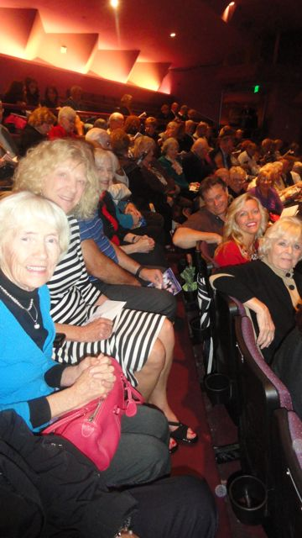
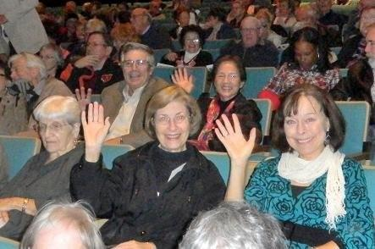
Theatre Outing
•Loop •Captions

Slide 78
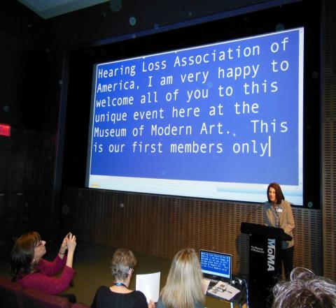
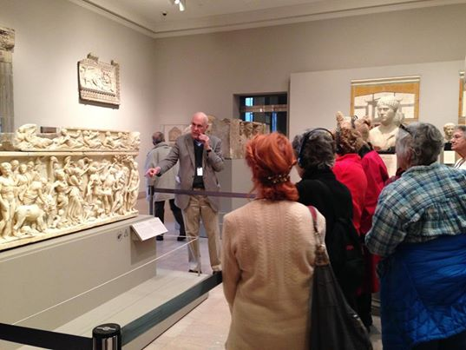
Access Supported Museum Outings

Slide 79
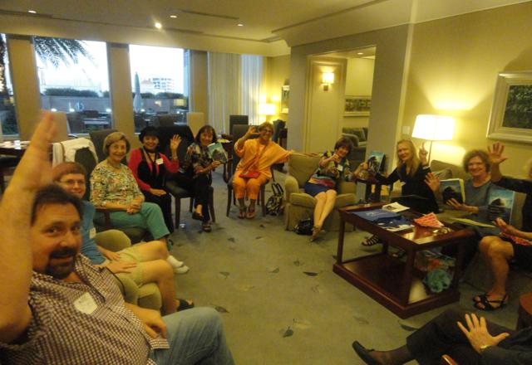
Book Clubs

Slide 80

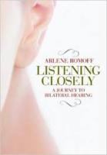



Book Club Selections
Listening Closely Arlene Romoff
Hear Again Arlene Romoff
Shouting Won’t Help Katherine Bouton
Listening with the Heart - Relationships and Hearing Loss
Michael A Harvey
Rebuilt Michael Chorost
If A Tree Falls Jennifer Rosner
Not Fade Away Rebecca Alexander

Slide 81

Annual Social Goals
Attract members to attend average of 4+ meetings/events
Introduce 33% of members to access in community
Attract 50% of spouses/loved ones to meetings/events
Have 80%+ of members renew membership

Slide 82

Advocacy Plan

Slide 83
HLAA National’s 2017
Advocacy Priorities
Implementation of National Academy of Sciences, Engineering, and Medicine Report Hearing Health Care for Adults: Priorities of Improving Access and Affordability
Medicare hearing aid coverage
Providing input to FDA for OTC hearing aid rule-making
Supporting OTC Hearing Aid Act of 2016 to regulate OTC hearing aids

Slide 84

Basic Advocacy
Teach communication self-advocacy
Home
Work
Healthcare
Public Safety
Community
Make members aware of access in community
Looped venues
Captioned performances
CART supported events

Slide 85
Basic Advocacy
Encourage members to thank venues for access
Encourage members to promote access at favorite venues
Help members experience access with group outings
Media Advocacy – Press releases/letters to editors/ media blogs
Support State and HLAA initiatives

Slide 86
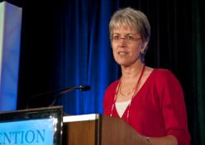
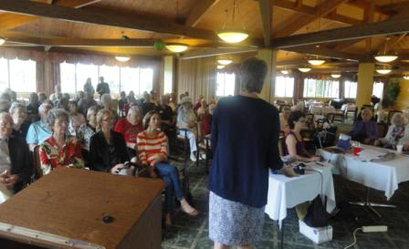
Advocacy Receptions
Dr. Juliette Sterkens
HLAA National Loop Advocate
Loop Target Venue Event
• Community Residence
• Library
• Theatre
Audiologist Event
Community Reception
Chapter Meeting

Slide 87
Set Annual Advocacy Goals
6 or more thank you letters to management at each looped, captioned or CART supported venue in town
6 or more member recommendations to their house of worship or favorite community venue to add access support

Slide 88

Volunteers

Slide 89



Slide 90

Volunteer Wish List
Greeters
Room set-up & Breakdown
Reception Host
Refreshment Manager
Peer Mentors
Event Planner
Photographer
Historian
President
Vice President
Secretary
Treasurer
Newsletter editor
Webmaster
Fundraising Chair
Membership Chair

Slide 91
Volunteer Wish List
• Information Manager
• Education Chair
• Social Chair
• Outreach Chair
• Media/Publicity Chair
• Volunteer Coordinator
• Technology Chair
• Advocacy Chair
• Facebook Administrator
Don’t forget Student Volunteers!

Slide 92
Sample Volunteer Appeal
Volunteers Needed
As we prepare for our 2015-2016 season we have a list of volunteer, as well as leadership, positions open. We need more volunteers to deliver our mission of opening the world of communication the insert # local people with hearing loss through information, education, advocacy and support.
Our chapter is a 501(c))(3) nonprofit organization with an all-volunteer staff. There are no paid positions and what we can do for our members and the community is totally dependent on the number of volunteers we get. And we could do so much more if we only had a few more volunteers who could offer as little as an hour a month.
We have a range of needs that should appeal to most interests and all level of skills to include: (Insert Wish List)

Slide 93

Volunteers
Make all leaders, members & contacts aware of volunteer needs
Promote the Wish List at all meetings/newsletters/mailings
Specific, measurable appeals work better than open-ended appeals
Make it FUN
Show APPRECIATION to your volunteers
Encourage members to invite others to volunteer
Spouses
Contacts
Students
Remember…they are VOLUNTEERS…and NOT employees. They have choices in how they spend their time!

Slide 94

Volunteers
Personally approach people for specific tasks
• Sell person on the need
• They are best person for job
Invite hearing professionals to volunteer
• Manufacturer Reps
• Audiologists / Their Patients
Network community contacts for volunteers
• Sertoma/Lions/Rotary
• Chamber of Commerce (Young Professionals)
• Students

Slide 95
Volunteers
Create an Advisory Board
• Identify volunteer candidates
• Open doors for advocacy initiatives
• Help identify fundraising options
• Promote awareness for chapter’s programs
Have an annual volunteer reception
• Thank current volunteers
• Focus at openings/new candidates

Slide 96

Managing Volunteers
1. Give volunteers meaningful jobs and responsibility
2. Discuss and agree on each job deliverables and expectations
3. When in doubt, let them define their job
4. Check in often on how they are doing
5. Thank publically at every meeting
6. Give your feedback and personal thanks privately
7. Give positive feedback publically
8. Ask them who they view as candidates

Slide 97

Attracting Leaders

Slide 98

Attracting Leaders
• Promote & Network the Wish List
• Source Leaders from Hearing Care Professionals/Community
• Establish an Advisory Board
• Personally sell on all candidate’s on the need/opportunity
• Have all leaders agree in advance to foundational responsibilities

Slide 99
Consider A Leader’s Agreement
1. Attend and participate in at least 3 of the 4 annual planning meetings
Participation includes having committee report submitted on schedule as requested by the chapter president.

Slide 100
Leader’s Agreement
2. Attend and participate in at least 5 of the 9 monthly chapter meetings.
• Greeting visitors and members before the meeting in accordance with the Welcome Strategy
• Socializing with visitors and members after the formal part of the meeting ends
• Connecting visitors and members with others who have common interests
• Promoting volunteer openings and selling candidates on the need to fill a specific job that matches their interest or skill set

Slide 101

Developing Leaders
Adjust entry step to interest & skill set
Volunteer job • 2nd Chair • 1st Chair • Officer
Discuss and agree to a short job description
Focus on deliverables
Develop leaders with training as appropriate
HLAA New Leaders Orientation Training
HLAA Hearing Loss Support Specialist Training Program
“Second Chair” Concept
Feedback

Slide 102

Awarness Building

Slide 103
Promote HLAA’s Value

Slide 104

Promote the value of the chapter

Slide 105
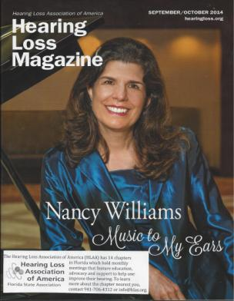
“Labeled” HLMs - Chapter’s Most Visible Vehicle
Placement Opportunities
Audiologist Office
Doctor’s Office
Dentist Office
Hairdresser’s Shop
Fitness Club
Label with:
Chapter Mission
Where/When Meets
Contact Info

Slide 106

# 1 Source of Awareness
.

Slide 107


Slide 108
Elevator Pitch
Monthly meetings that open the world of communication for people with hearing loss through:
• information
• education
• support
• advocacy
It has made a big difference for me by. . . . .

Slide 109
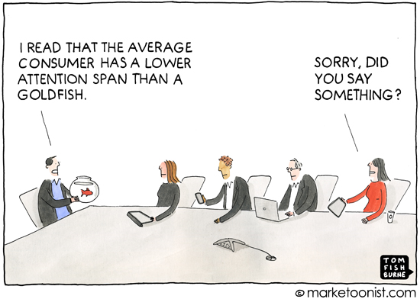
Goldfish Attention Span 9 seconds
Human attention span (2014) 8 seconds

Slide 110
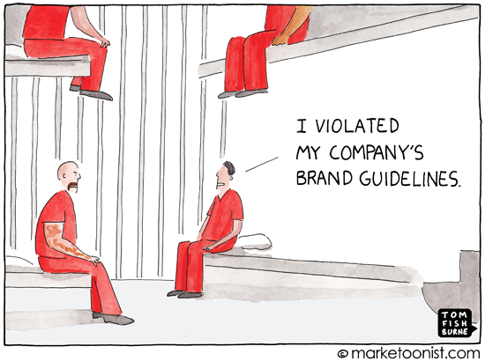
Branding

Slide 111





Brand Every Chapter Message
Flyers
Reception Table
Welcome Kit
Newsletters
FaceBook
Website
Letters w/stationary
Meetings w/ biz card card
Email w/signature

Slide 112



Which logo is correct?
A
B
C

Slide 113

Chapter & Personal Branding
This?
or This?
From: lacy75@msn.com
Subject: Meeting today
Signature: Lacy
From: Lacy Lee
Subject: Meeting Today
Signature: Lacy Lee
President, HLAA, DC Chapter
Lacy.Lee@hlaa-dc.org
www.hlaa.org
www.hlaa-dc.facebook.com
201-757-5757

Slide 114


E-mail
List Target: 10 to 1 email/ meeting attendance ratio
Build list from: •Visitors • Outreach •HLAA Members List •Audiologists •Disability/Support Groups •Advisory Group •Donors • Sponsors • Exhibitors
Get an e-marketing management account Free

Slide 115
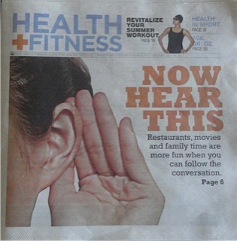
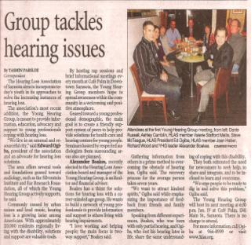
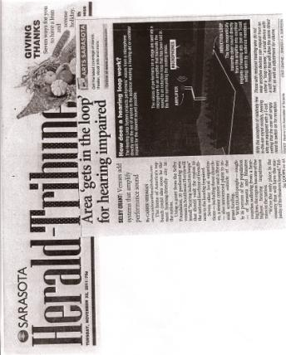
Media Management
Calendar Listings
Health/Senior/Charity Directories
Respond to Articles / Blogs
Become THE Resource:
Health Editor
Community Editor
Letters to Editor
Press Releases for Real News
Partnership Support

Slide 116
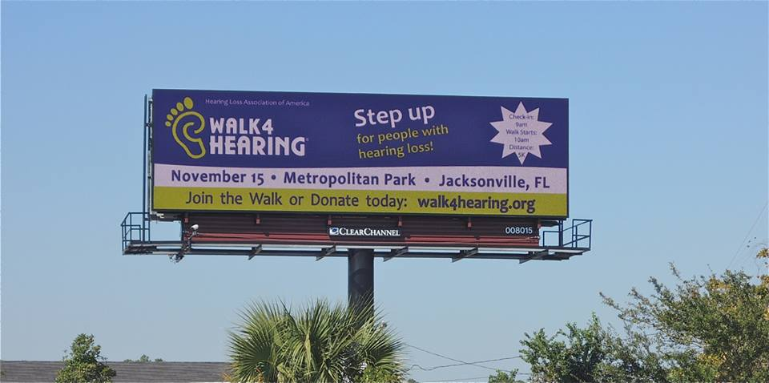
Partnership Ads

Slide 117

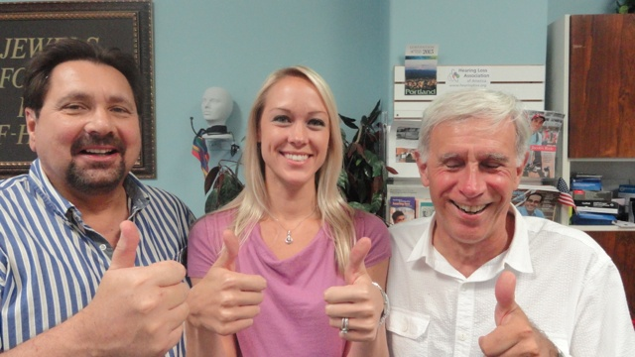

Slide 118

35th Anniversary
One chapter event a month from Nov 2014 to Nov 2015
Opportunity to re-freshen chapter interest
Opportunity to get community’s attention
• news
• added credibility

Slide 119
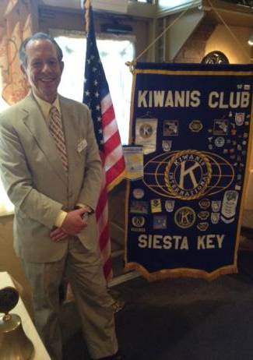
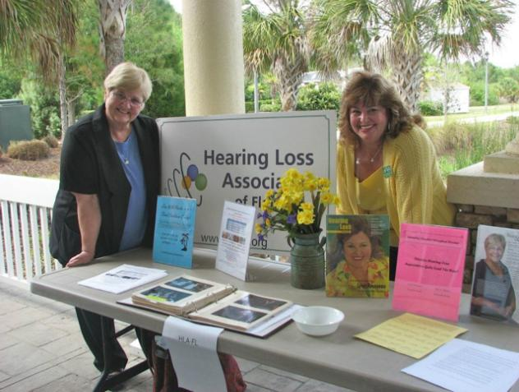
Outreach

Slide 120

Why Outreach?
Greatest source for building email list
Feature chapter monthly news and information
Greatest source of first time visitors
Focus at upgrading information requests with mentoring
Largest source of new members
The future of HLAA successful chapters.
Do the math.

Slide 121
The Washington 2% Opportunity
Chapter | People with Hearing Loss | Suppose 2% Join Your Chapter
East Jefferson County WA | 4,344 | 87 Members
Renton WA | 18,185 | 364 Members
Spokane WA | 133, 249 | 2665 Members
Tacoma-Seattle Area | 687,962 | 13,739 Members
Washington State Opportunity | 843,740 people | 16,875 Members

Slide 122
The Oregon Opportunity
Chapter | 2010 Census population | People w Hearing loss (20%)
Douglas County OR | 107,667 | 21,533
Lane County OR | 351,715 | 70,343
Linn & Benton OR | 202,248 | 40,450
Portland OR | 2,226,009 | 445,202
Salem OR | 390,738 | 78,148
Whatcom OR | ?? | ??
Total | 3, 278, 377 people | 655,676 people

Slide 123
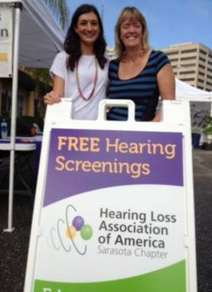
Outreach
Partner with an Audiologist to offer FREE SCREENINGS
Presentations
Community Residences
Sertoma/Lions/Rotary Clubs
Audiologist Education Events
Information Support Booths
Health Fairs
Farmer’s Markets
Community Events

Slide 124
Strategic Partnerships

Slide 125
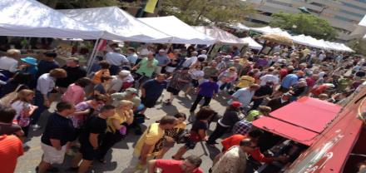
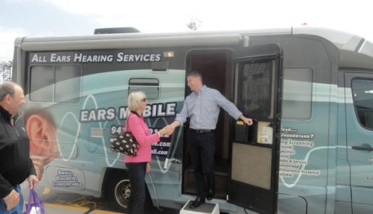

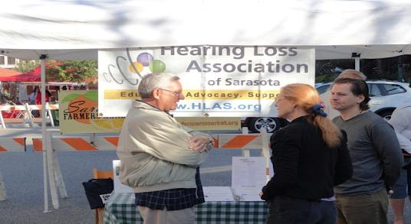
Free Screenings with Audiologists

Slide 126
Special Education Programs
Lip Reading Treasure Coast Chapter + Lions Club
Auditory Training Sarasota Chapter + USF Audiology
Convention Kentucky Chapters + Kentucky CCDHH

Slide 127
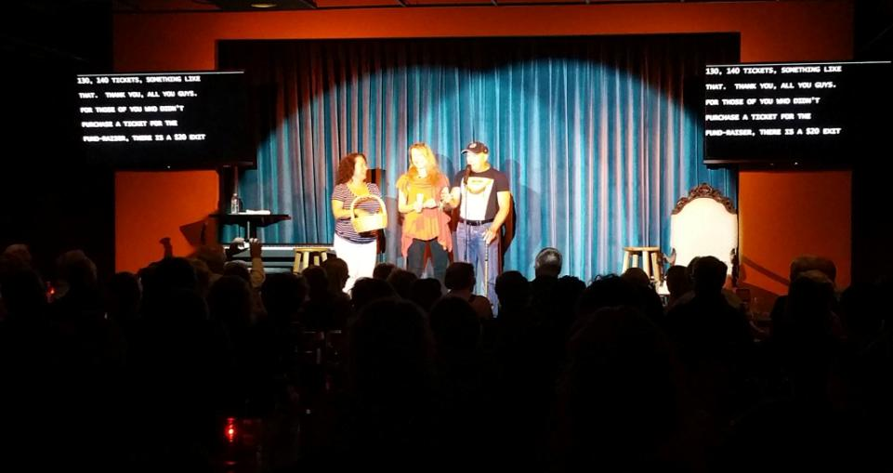

CART + Loop Advocacy @ Theatre

Slide 128
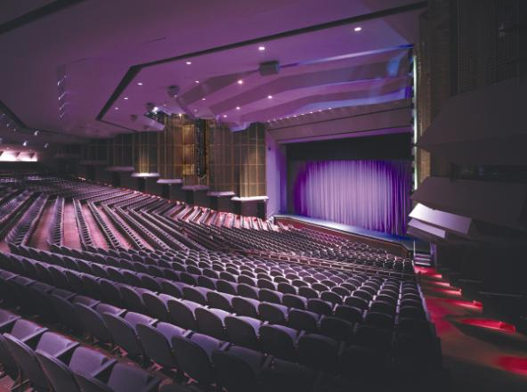


Advocacy Program

Slide 129

Veterans

Slide 130

Veteran’s Symposium
Panel
VA Services Review
Q&A
Presentations
New Technologies
What HLAA Offers
Exhibitors

Slide 131

Fundraising

Slide 132

Why Raise Funds?
Better support members
  CART • Refreshments • Information
  Member outings to movies, theatre and museums
  Social events
Nurture and develop volunteers/leaders
  HLSST Scholarship
  Gallaudet Peer Mentoring Program Scholarship
  HLAA Convention Scholarships
  Volunteer Reception
Better support community
  Outreach Program
  Community Receptions

Slide 133


Slide 134

Fundraising Wish List Basics
CART
Meetings
Chapter Events
Community Events
Loop System / Loop Receivers for all meeting venues

Slide 135
Fundraising Wish List Basics
Sending volunteers and future leaders to:
Hearing Loss Support Specialist Training
HLAA National Convention
Supporting the Community
Outreach event expenses
Education event expenses

Slide 136

Sources of Funds
Donations
Walk4Hearing
Membership Dues
Events
Sponsors
Exhibitors
Community Organizations
Grants

Slide 137

Demonstrate how different $ amounts make a difference:
$25 Refreshments for one meeting
$50 Informational materials for 2 to 3 events
$100 Loop receiver for meetings/events use
$150 CART for one meeting or event
$275 HLSST Scholarship to train a mentor
$500 Outreach event in community
$1000 Scholarship to HLAA National Convention
$1200 CART for all meetings in one year
$2500 Loop system for venue/chapter meetings

Slide 138

Sources of Funds for Chapters - Events

Slide 139

Community Sources of Funds
Foundations
• Community Foundation
Organizations
• e.g. SERTOMA
Identify Local Sources • Research
• Letter of Inquiry
• Submit Grant

Slide 140



Attracting Young Adults

Slide 141
Attracting Young Adults
1. Who is your target?
2. What are their needs?
3. What images & programs appeal to them?
4. How to find young leaders

Slide 142
Target Audience – Young Adults
WHO | NEEDS
Young Professionals | Managing workplace communication access & relationships
College Students | Preparing for the workforce
Teens | Social acceptance & peer pressure
Children | Parental guidance

Slide 143
Options
Chapter Programming Focused on Young Adults
• Hartford Parents with children
• Essex County Parents with children
• Boston and DC Students
Chapter Young Adult Special Interest Groups (SIGs)
Sarasota After Hours Young Adults
Working People
District of Columbia Gallaudet University Students
Special Events/Programs Appealing to Young Adults
Don’t overlook Walk4Hearing to Engage Young Adults

Slide 144
Events/Programs for Young Adults
1. Audiology Student Programs
• Presentations to training programs
What I wish my audiologist knew about my hearing loss
• Summer Intern Program
• AudioBuds Support Program
Matched with Member in Buddy System
• Special Memberships

Slide 145
Events/Programs for Young Adults
2. Young Professional Symposium
How to manage relationships with hearing loss
Latest technologies
How to survive and thrive in the workplace
3. Student Symposium
How to survive and thrive in school & workplace
Latest Technologies
Resume Strategies
Interview Strategies

Slide 146
Events/Programs for Young Adults
4. Student / Young Professional Volunteer Program
Meaningful volunteer jobs in technical, social media, outreach
Provide references for resume-building
5. Young Awareness Program
Use Facebook to reach younger adults

Slide 147

Hearing Healthcare Professional Collaborations

Slide 148

Become an HLAA Pro Member
Joint Outreach Event with Free Hearing Screenings
Joint Community Presentation
HLAA Presentation @ clinic
Practice Listed on HLAA web
Materials at Chapter Meetings
HLAA Waiting Room Support
Speak at HLAA meeting
Exhibitor Discount for Expo
Discount for Newsletter Ad
Article in Chapter Newsletter

Slide 149

State Support

Slide 150
State Speaker’s Guild
• Chapters’ Most Popular Topics/Speakers
• Audiology Professors
• Videos

Slide 151

State Mailing List

Slide 152
HLAA Leader Support
Annual Requirements
Start A Chapter
Run A Strong Chapter
Legal/Governance
Financial
Publicity Promotion
Coordinators
State Organizations

Slide 153

HLAA Leader Support

Slide 154


HLAA Leader Support
New Leader Orientation
(single leader)
Established Leader Training (one or group of leaders)
Chapter Priority Session
(leaders from one chapter)
Chapter Building Workshop
(leaders from 3+ chapters)

Slide 155

Leaders Checklist
Wednesday June 22nd 1 pm
All Leaders Chapter Development Workshop
Wednesday June 22nd 3:30 PM
State Coordinators Workshop
State/Chapter Development Workshops through out the day Thu-Fri-Sat

Slide 156

Run A Strong Chapter - Is It Time For A Chapter Tune-Up

Slide 157

Find An HLAA Chapter

Slide 158
HLAA Information/Education/Support
• HLAA Hearing Help: Tech/Parents/Vets/Young Adults
• Support: Financial/Professionals/Links/Order Materials
• Hearing Loss Magazine
• Hearing Loss Brochures
• Hearing Loss Videos
• Webinars
• Training: Support Specialists / HAT
• Forums and Chat Rooms
• Leaders Blogs
• eNews
• Website resources
• Convention
• Support Programs
• Benefits of Membership

Slide 159


Communications
State & Chapter Development Blog
Chapter Leaders Listserv
E-News
Hearing Loss Magazine
This Week In Bethesda
Facebook

Slide 160

Other Chapter Needs

Slide 161

Vision

Slide 162


Slide 163

Highest Current Rate
0.2%
2 out of 1000

Slide 164

Next Steps

Slide 165

Next Steps
1. Establish chapter and personal credibility
• Chapter logo on all communications
• Mission Statement with local HL population
• Promote Chapter Value/Services
• Top 10 Reasons to Join HLAA/Chapter
• Feature Mentors / Other Leaders
• Chapter Signature on all e-mails

Slide 166
Next Steps
2. Information/Support Plan
• Welcome / Greeting Plan
• Welcome ”Kit”
• Leader requirement to greet visitors
• Information Table
• Develop Mentors with HLSST
• Leader requirement to socialize with members

Slide 167
Next Steps
3. Education Plan
• Develop Wish List
• Focus each topic at improvement
• Focus meeting flyer headline at improvement
• Support w/ 3 to 4 lessons one will learn
• Deliver Education Basics at all meetings
• Conduct Rap Session

Slide 168
Next Steps
4. Recruit Volunteers
• Develop Wish List
• Focus each leader / members at recruiting
• Feature needs at every meeting
• Provide list of openings in communications
• Personally sell candidates to take a job
• Have leaders sign on for responsibilities
• Reach out to outsiders

Slide 169
Next Steps
5. Social Plan
• Leaders Meet and Greet before meetings
• Leaders introduced at meeting
• Leaders connect with members after speaker
• Use Rap Session to link kindred spirits
• Plan community events

Slide 170
Next Steps
6. Advocacy Plan
• Teach members how to self advocate
• Provide CART at all meetings
• Provide a Loop at meetings
• Encourage members to thank venues with access
• Encourage members to establish need for access
• Support State’s Public Policy Agenda

Slide 171
Next Steps
7. Awareness Building Plan
• Feature Top 10 Lists
• Consistent Branding Strategy on all communications
• Build e-mail list
• Meeting Flyers that highlight benefits/learning
• Community Calendar listings
• Establish chapter as a hearing health media source

Slide 172
Next Steps
8. Fundraising Plan
• Use Unified Membership to Grow Membership
Ask for Donations
Participate in Walk4Hearing
•Wish List focused at supporting members/leaders
• Identify Community Foundation/other contacts
• Letters of Inquiry
• Proposals

Slide 173
Next Steps
9. State Plan
State Coordinators Support Plan for Chapters
Work with State Organizations
Build master mailing list with chapters’ list
Feature chapter profiles in newsletter
Build Speak Guild List with chapters’ input
Take lead on fundraising
Consider regional/state educational event

Slide 174
Next Steps
10. Community Plan
• Outreach – every chapter should pilot test
• Community Social Plan
• Advisory Board- every chapter needs one
• Collaborate with Audiology Schools
• Connect with Sertoma, Lions, Rotary

Slide 175


Slide 176



Slide 177

What two words?

